Slide 1

Here you will find a mixture of small sided games which have all been utilised within sessions whilst working with a women's first team. With both 4v4 and 6v6 games these could be perfect for nights you find a smaller group in attendance.
Hope it is of help to you, if you have any questions, you’ll get me on @TheGlasgowFC on all social media platforms!

Slide 2
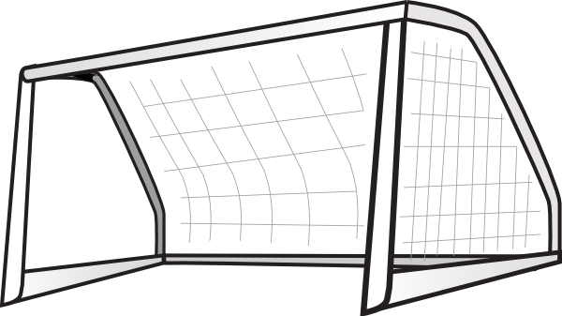
Numbers Game (20 Minutes)
Setup
Small 15x15 yard box setup with goals at both ends. Split group up into two teams, orange v yellow. Ask them both to number each other. Players begin behind their goal.
C
15
Practice Detail
Coach calls number for a 1v1 to begin. Play stops when one of the players scores a goal or the ball goes out of the pitch, whatever occurs first.
Coaching Points
Attack at pace, look to exploit the defensive player being flat footed. Encourage skill moves to dribble past the defender. Defensively, players should focus on showing attacker wide and trying to show the out of the pitch. If successful in winning the ball, transition to attack quickly.
15
Progressions
Progress to having more than one 1v1 running concurrently on the same pitch. Build up to 2v1 with the losing player remaining on the pitch. Go to 2v2 and then finish with 3v3s.

Slide 3

4 Goal Game (20 Minutes)
20
Setup
A 4-goal pitch, 20x20 yards. Emphasis on a tight pitch area to make both teams have lots of decisions to make. Cone off pitch, four Mini Goals set out 5 yards inside with 10-yard gap between. Target Zone set with flat markers 4 yards in from goals.
20
Practice Detail
Each team defends 2 goals and scores in 2 goals. Great set up to encourage; dispersal and switching play. Out of possession a good one for defending as a team, which goal to cut off? 1 Point for playing into target area, 2 points for scoring a goal.
Coaching Points
In possession (Attacking) Disperse and use the full width of the pitch. Have the ability to switch play through a ‘pivot’ player in the centre. Recognise when to switch from a highly concentrated area to a low area. Out of possession (Defending) Dictating the area, the attackers can play into. Defending in 1v1 / 2v2 around the goal. Emergency defending to block and stop shots.
Progressions
Can only score from a one-touch finish. Add target players in the target zone to play into before being allowed to score.

Slide 4
2 Goal Rotation Game (20 Minutes)
15
Setup
4v4. Yellows v Orange bibs. 15 long x 10 wide pitch. Yellow – Mo, Erin, Sam & Sarah. Orange – Rachel, Hope, Lizzie & Adele.
Practice Detail
Game Rules No offside. If ball leaves play, the coach has a few re-start options: The coach passes a new ball onto the pitch. The players take a throw in. The players make a pass. The players dribble I The game is played for 20 minutes. This is broken down into 4x4 minute periods with one-minute breaks in between. After each round the players rotate to the next position on their right. This rule will see the players playing in all four positions of the diamond [top, bottom, left and right] also the players will also come up against a different opponent in each period of the game
10
Coaching Points
Look for diamond shape to provide width and depth. Remind players they need to keep a balance in defending and attacking. Look for them to take advantage of scenarios when the opposition reacts slowly. Communication.

Slide 5
Target Game (20 Minutes)
3
15
Setup
4v4. Yellows v Orange bibs. 15 long x 10 wide pitch.
10
Practice Detail
Game Rules No offside. If ball leaves play, the coach has a few re-start options: The coach passes a new ball onto the pitch. The players take a throw in. The players make a pass. The players dribble in. The game is played for 9-minute halves. With a two-minute break in between. Each team sends one player to be the “target player”. This players stands in the attacking end zone. The aim of the game is to play a pass into your target & then receive a lay off pass in order to shoot at goal. After a shot is made, the shooting player changes positions with the target.
3
Coaching Points
Let the game flow freely, let the players solve the problems . Remind players they need to keep a balance in defending and attacking. Encourage players to react quickly to the ball going out of play, can we score? Do I need to defend? Look for them to take advantage of scenarios when the opposition reacts slowly. If opposition defend one goal, can we switch the play?

Slide 6
Directional Game (30 Minutes)
Setup
20-yard square. 4v4 – Oranges v Yellows. 4 Mini Goals split equally on outside as shown.
Practice Detail
One team attack the goals across the width of the pitch. One team attack the goals down the length of the pitch 15 Minute Game. If a goal is scored or a ball leaves play, the coach passes a new ball onto the pitch
Coaching Points
Let the game flow freely, not too much stops, let the players solve the problems . Look for diamond shape when attacking (width and depth.) Remind players they need to keep a balance in defending and attacking. Encourage players to react quickly to the ball going out of play, can we score? Do I need to defend? Look for them to take advantage of scenarios when the opposition reacts slowly. If opposition defend one goal, can we switch the play? Communication. End product.
Progressions
Take side goals away and play 15 minutes of free play, Open pitch out to a 25-yard square.

